Slide 1
ATIVIDADE UC11-TESTE DE FRONT END
MATHEUS LEMOS CARVALHO

Slide 2
PLANO DO TESTE
Objetivo de testar a funcionalidade da barra de pesquisa do site https://informatica.sp.senai.br/.
Softwares utilizados: Eclipse, JDK-8 e WebDriver.

Slide 3
Curso do teste
Usuário acessa o site.
Clica na barra de pesquisa, digita o conteúdo do seu interesse.
Clica no botão de pesquisar ou “enter”.
Resultados da pesquisa aparece na tela do usuário.

Slide 4
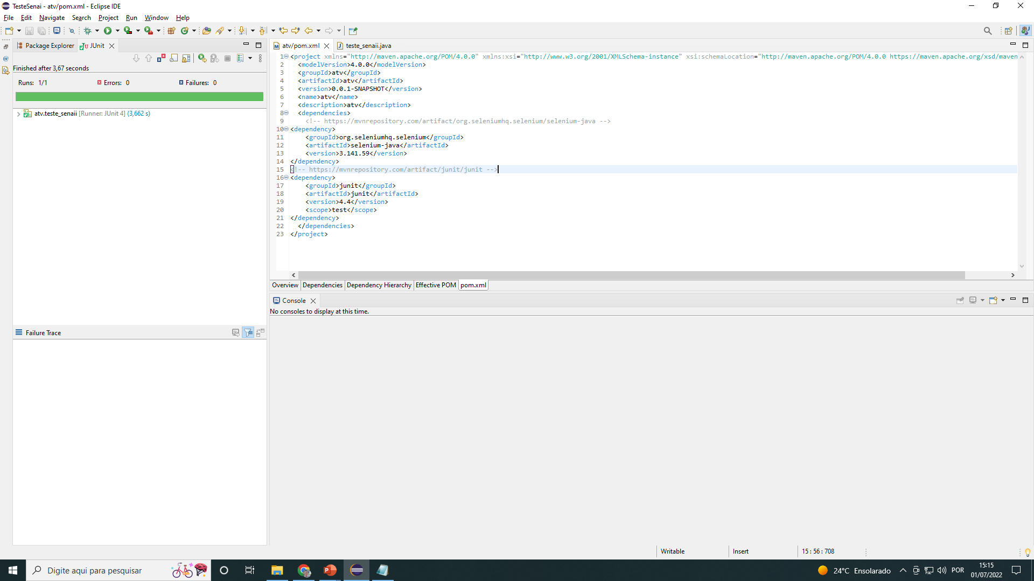
print teste : Pom xml : pesquisa informatica

Slide 5
Código pom xml:
<project xmlns="http://maven.apache.org/POM/4.0.0" xmlns:xsi="http://www.w3.org/2001/XMLSchema-instance" xsi:schemaLocation="http://maven.apache.org/POM/4.0.0 https://maven.apache.org/xsd/maven-4.0.0.xsd">
<modelVersion>4.0.0</modelVersion>
<groupId>atv</groupId>
<artifactId>atv</artifactId>
<version>0.0.1-SNAPSHOT</version>
<name>atv</name>
<description>atv</description>
<dependencies>
<!-- https://mvnrepository.com/artifact/org.seleniumhq.selenium/selenium-java -->
<dependency>
<groupId>org.seleniumhq.selenium</groupId>
<artifactId>selenium-java</artifactId>
<version>3.141.59</version>
</dependency>
<!-- https://mvnrepository.com/artifact/junit/junit -->
<dependency>
<groupId>junit</groupId>
<artifactId>junit</artifactId>
<version>4.4</version>
<scope>test</scope>
</dependency>
</dependencies>
</project>

Slide 6
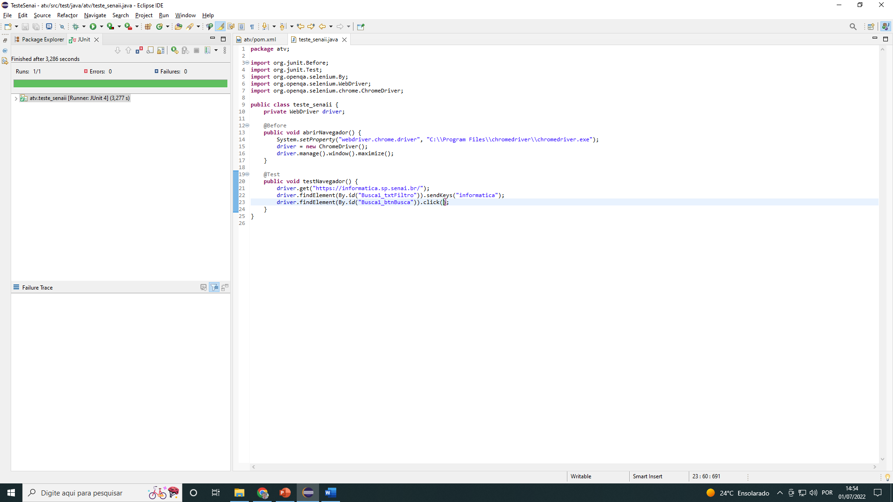
Print teste: java : Pesquisa informatica

Slide 7
Código java:
package atv;
import org.junit.Before;
import org.junit.Test;
import org.openqa.selenium.By;
import org.openqa.selenium.WebDriver;
import org.openqa.selenium.chrome.ChromeDriver;
public class teste_senaii {
private WebDriver driver;
@Before
public void abrirNavegador() {
System.setProperty("webdriver.chrome.driver",
"C:\\Program Files\\chromedriver\\chromedriver.exe");
driver = new ChromeDriver();
driver.manage().window().maximize();
}
@Test
public void testNavegador() {
driver.get("https://informatica.sp.senai.br/");
driver.findElement(By.id("Busca1_txtFiltro")).sendKeys("informatica");
driver.findElement(By.id("Busca1_btnBusca")).click();
}
}

Slide 8
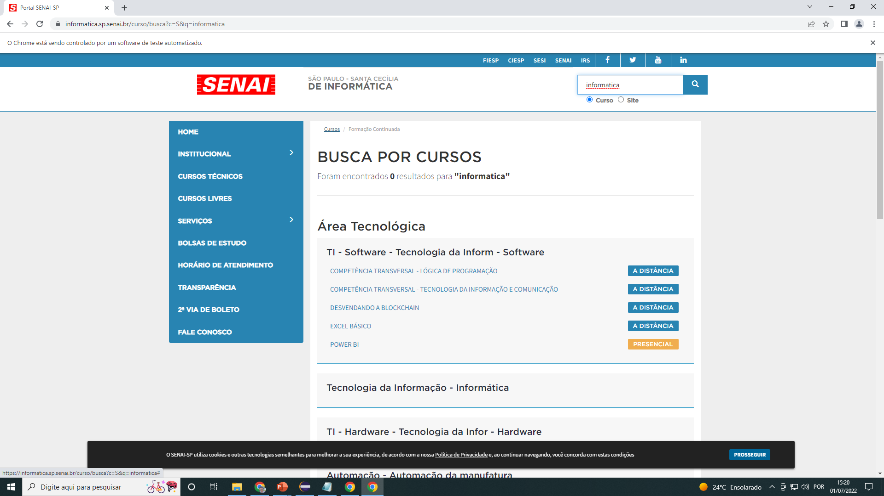
resultado

Slide 9
print teste : Pom xml : pesquisa gestao

Slide 10
Código pom xml:
<project xmlns="http://maven.apache.org/POM/4.0.0" xmlns:xsi="http://www.w3.org/2001/XMLSchema-instance" xsi:schemaLocation="http://maven.apache.org/POM/4.0.0 https://maven.apache.org/xsd/maven-4.0.0.xsd">
<modelVersion>4.0.0</modelVersion>
<groupId>atv</groupId>
<artifactId>atv</artifactId>
<version>0.0.1-SNAPSHOT</version>
<name>atv</name>
<description>atv</description>
<dependencies>
<!-- https://mvnrepository.com/artifact/org.seleniumhq.selenium/selenium-java -->
<dependency>
<groupId>org.seleniumhq.selenium</groupId>
<artifactId>selenium-java</artifactId>
<version>3.141.59</version>
</dependency>
<!-- https://mvnrepository.com/artifact/junit/junit -->
<dependency>
<groupId>junit</groupId>
<artifactId>junit</artifactId>
<version>4.4</version>
<scope>test</scope>
</dependency>
</dependencies>
</project>

Slide 11
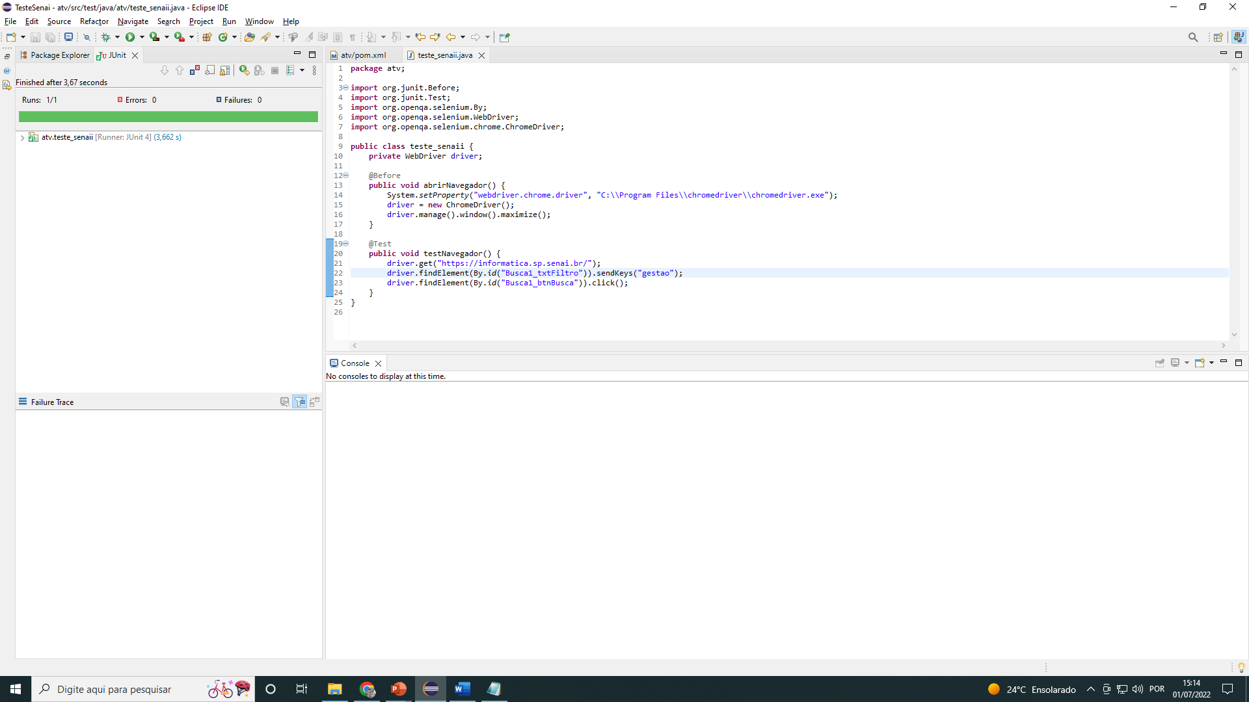
Print teste: java : Pesquisa gestao

Slide 12
Código java:
package atv;
import org.junit.Before;
import org.junit.Test;
import org.openqa.selenium.By;
import org.openqa.selenium.WebDriver;
import org.openqa.selenium.chrome.ChromeDriver;
public class teste_senaii {
private WebDriver driver;
@Before
public void abrirNavegador() {
System.setProperty("webdriver.chrome.driver",
"C:\\Program Files\\chromedriver\\chromedriver.exe");
driver = new ChromeDriver();
driver.manage().window().maximize();
}
@Test
public void testNavegador() {
driver.get("https://informatica.sp.senai.br/");
driver.findElement(By.id("Busca1_txtFiltro")).sendKeys(“gestao");
driver.findElement(By.id("Busca1_btnBusca")).click();
}
}

Slide 13
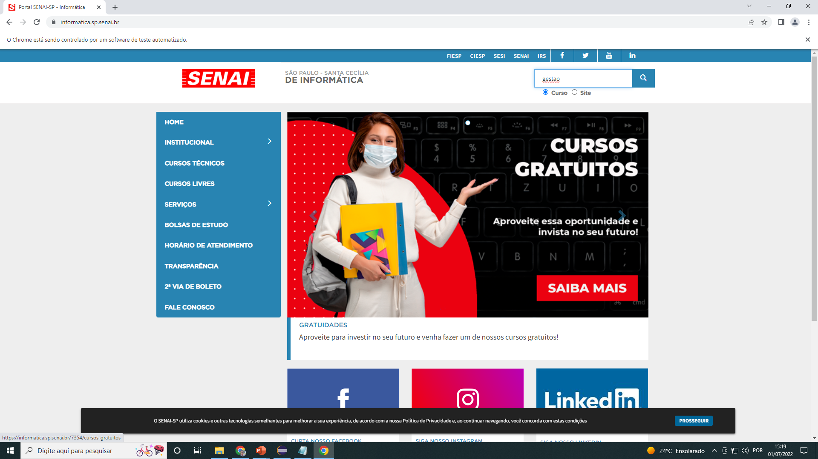
resultado

